Slide 1

ABFRL Brands-Quick Checkout Flow App Tagging
11th October 2023

Slide 2
Guidelines to Implement Tagging
Adobe Launch SDK should be installed before the custom tagging.
Copy and paste the keys of contextData as it is without changing the Camel Casing.
Context Data should be along with calling the Track State and Track Action functions.
<> this indicates dynamic value to be captured and passed.
Icid will be added to the next page’s URL where user lands after clicking any content of current page.
Testing will be performed by Implementation Team after ABFRL QA team will give the confirmation/sign off for the testing done by them.
UAT should be done first in staging and then in production post production UAT adobe’s codes are pushed to live.
For Customer ID, pass the value only when available else pass it as blank.

Slide 3
Super App Brands
Since Super App contains multiple cross-brands journey, therefore w.r.t to tracking the brand/product brand currently included( along with the value to be passed in the contextData key)
Brand/Product Brand | Context Data Value
Van Huesen | vh
Peter England | pe
Allen Solly | as
Louis Phillipe | lp
Reebok | reebok
American Eagle | aoe
Forever 21 | f21
Simon Carter | sc

Slide 4

Quick Checkout

Slide 5
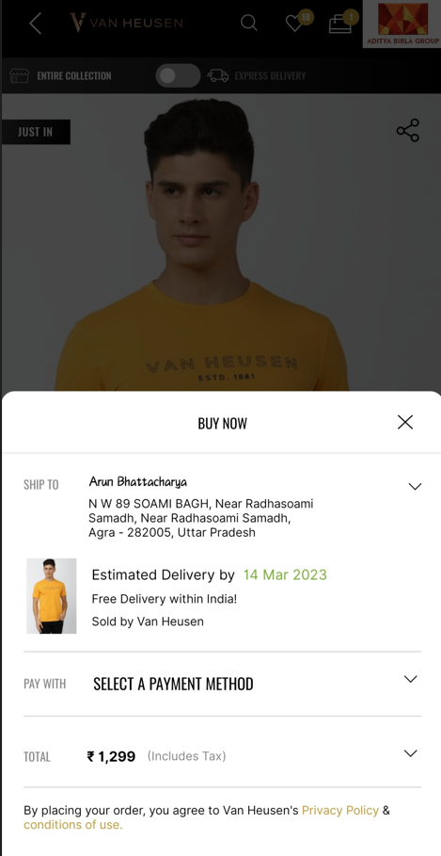
On Quick Checkout page load

Slide 6
Page Type | Tracking Type | Launch variables | Expected Values
Quick Checkout Page | onload | let contextData={}; let contextData={ pageName: “quick checkout page", parentPage : “product page", channel: "<android/ios>|checkout", &&events : “scCheckout,event13,event14,event15,event61,event87”, customerID : "<customerID>", loginStatus : "<logged-in>", pageType : “quick checkout page“ &&products : ";<product 1 id>;;;event13=<product 1 marked price>|event14=<product 1 selling price>|event15=<product 1 discount amount>|event61=<product 1 quantity>;eVar19 = <product 1 category>|eVar30=<product 1 name>|eVar32=<product 1 brand name>| eVar33= <product 1 stockStatus>|eVar34=< product 1 color>|eVar35=<product 1 size>|eVar36= <product 1 genderType>|eVar44=<product 1 style code>, platform: "<android/ios>", userDetails: "<gender>|<age>", dob: "<date of birth>" }; ACPCore.trackState(“quick checkout page", contextData); | loginStatus may have the values:- logged-in guest productID: will have the value of SKU ID of the product. productCategory: will have the category of the product. Example:- shirt trouser productMarkPrice: will contain the MRP of the product. productSellPrice: will contain the actual selling price of the product. productQuantity: will have the quantity selected for the product. productName: name of the product. brandName: name of the brand of the product. stockStatus: provide whether product is instock or out of stock eg – stockStatus : “out of stock” or “available” color: example values: Red. size: example values:- 42 L styleCode: will contain the style code of the product. Example value:- PESFONUB236782 productDiscount will have the discount applied on the product. productGenderType Example value:- female couponCode If a coupon is applied as per below example:- If coupon code is NEW100 worth of 100 Rs for PE. Then the value will be: "NEW100-peter England-100|OFF50-allen solly-500”.

Slide 7
On clicking on Change Address Button

Slide 8
Click Type | Tracking Type | Launch variables | Expected Values
Change Selected Address | CTA | let contextData={ linkName:"change address", channel:"<android/ios>|checkout", linkPageName: “quick checkout page", customerID : "<customerID>", loginStatus : "logged-in" , pageType : “quick checkout page", platform: "<android/ios>", userDetails: "<gender>|<age>", dob: "<date of birth>" }; ACPCore.trackAction(“quick checkout change address", contextData) | loginStatus may have the values:- logged-in guest

Slide 9
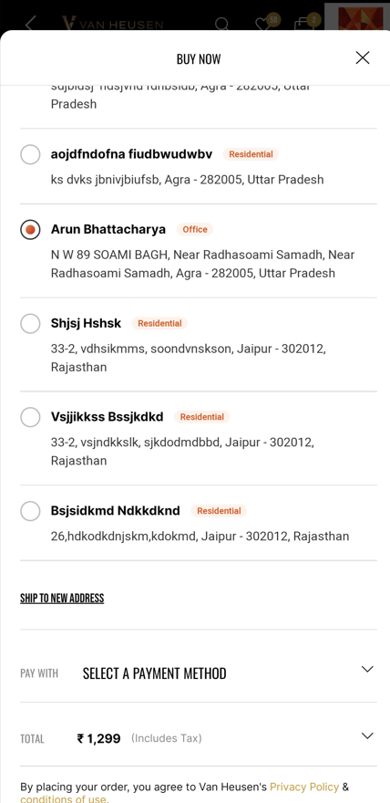
On click of Add New Address

Slide 10
Click Type | Tracking Type | Launch variables | Expected Values
Add new address | button | let contextData={ linkName: “ship to new address", channel: "<android/ios>|checkout", linkPageName: “quick checkout page", customerID : "<customerID>", loginStatus : "logged-in" , platform: "<android/ios>", userDetails: "<gender>|<age>", dob: "<date of birth>" }; ACPCore.trackAction(“ship to new address", contextData); | loginStatus may have the values:- logged-in guest

Slide 11
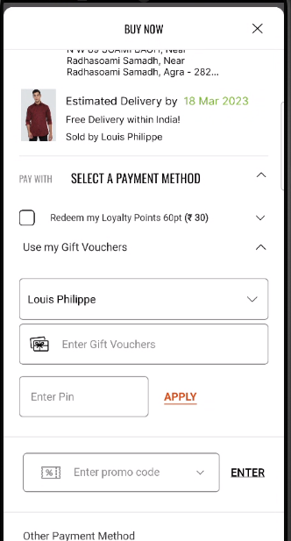
On Applying gift voucher

Slide 12
Click Type | Tracking Type | Launch variables | Expected Values
Gift voucher | button | let contextData={ linkName:"<cta name>", channel:"<android/ios>|checkout", linkPageName: “quick checkout page", customerID : "<customerID>", loginStatus : "logged-in" , pageType : “quick checkout page", appliedGiftVoucher: "<voucher code>-<brand name>”, platform: "<android/ios>", userDetails: "<gender>|<age>", dob: "<date of birth>" }; ACPCore.trackAction(“<cta name>", contextData) | loginStatus may have the values:- logged-in guest appliedGiftVoucher: If a gift voucher is applied as per below example:- If gift voucher is NEW200 worth of 200 Rs for PE. Then the value will be: "NEW200-pe"

Slide 13
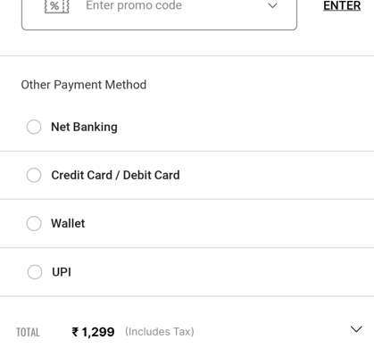
On click of payment option
x
x

Slide 14
Click Type | Tracking Type | Launch variables | Expected Values
Payment option selection | Radio button | let contextData={ linkName:"<payment method>", channel:"<android/ios>|checkout", linkPageName: “quick checkout page“, customerID : "<customerID>", loginStatus : "logged-in" , pageType : “quick checkout page", platform: "<android/ios>", userDetails: "<gender>|<age>", dob: "<date of birth>" }; ACPCore.trackAction(“<payment method>", contextData) | loginStatus may have the values:- logged-in guest

Slide 15
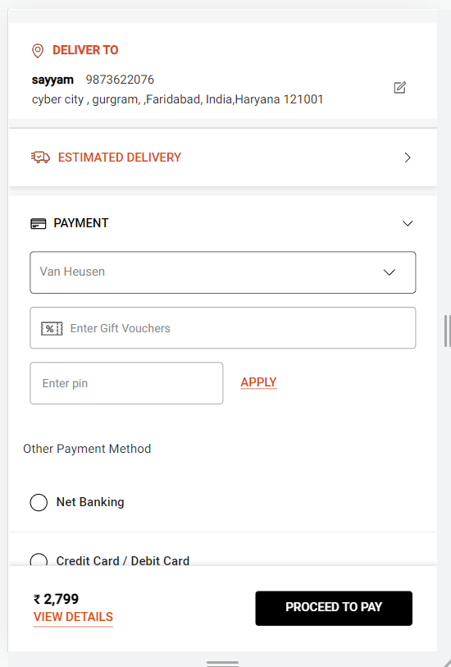
On click of Place order

Slide 16
Click Type | Tracking Type | Launch variables | Expected Values
Place Order | button | let contextData={ linkName: “<cta name>", channel:"<android/ios>|checkout", linkPageName: “quick checkout page", customerID : "<customerID>", loginStatus : "logged-in" , pageType : “quick checkout page", &&events : “event31,event13,event14,event15,event61,event62=<number of total Products initiated for order>”, &&products : "<;product 1 id;product 1 quantity;product 1 selling price;event13=product 1 marked price|event14=product 1 selling price|event15=product 1 discount amount|event61=product 1 quantity;eVar19 = product 1 category|eVar30=product 1 name|eVar32=product 1 brand name| eVar33= product 1 stockStatus|eVar34= product 1 color|eVar35=product 1 size|eVar36= product 1 genderType|eVar44=product 1 style code>, couponDetails : “<coupon 1 code-coupon 1 brand name>| <coupon 2 code – coupon 2 brand name>|<…coupon N code-coupon N brand name>”, // pass only when coupon/s are applied. platform: "<android/ios>", userDetails: "<gender>|<age>", dob: "<date of birth>" }; ACPCore.trackAction(“<cta name>", contextData) | loginStatus may have the values:- logged-in guest productID: will have the value of SKU ID of the product. productCategory: will have the category of the product. Example:- shirt trouser productMarkPrice: will contain the MRP of the product. productSellPrice: will contain the actual selling price of the product. productQuantity: will have the quantity selected for the product. productName: name of the product. brandName: name of the brand of the product. stockStatus: provide whether product is instock or out of stock eg – stockStatus : “out of stock” or “available” color: example values: Red. size: example values:- 42 L styleCode: will contain the style code of the product. Example value:- PESFONUB236782 productDiscount will have the discount applied on the product. productGenderType Example value:- female couponCode If a coupon is applied as per below example:- If coupon code is NEW100 worth of 100 Rs for f21. Then the value will be: "NEW100-f21-100|OFF50-sc-500”. voucherCode If a gift voucher is applied as per below example:- If gift voucher is NEW200 worth of 200 Rs for sc. Then the value will be: "NEW200-f21-200|DIWALI40-sc-700“ loyaltyAmount If a loyalty amount is applied as per below example:- If total loyalty amount available is Rs1000 and Rs900 is used for f21. Then the value will be: “900-f21-100|750-sc-250“ myCredits If credit amount is applied as per below example:- If total credit amount available is Rs3000. For sc Rs2000 is available and Rs1800 is used. For f21 Rs1000 is available and Rs900 is used. Then the value will be: “1800-sc-200|900-f21-100“

